Slide 1
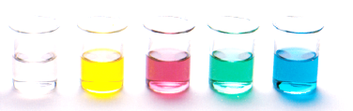
Acid and base – Organic chemistry
Acid and base properties of Carboxylic acids
Acid and base properties of Alcohols
Resources
Essential chemistry, ch 12.3
Set 18 Q 1-4

Slide 2
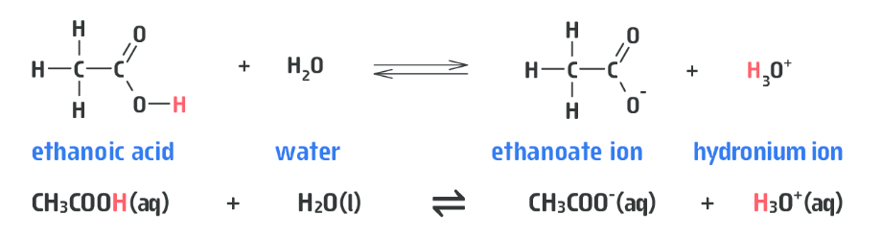
Carboxylic acids
Carboxylic acids are weak acids
When dissolved in water they donate a proton to produce a hydronium ion, H₃O⁺ thus lowering the pH
It is only the hydrogen of the carboxyl groups that shows acidic properties

Slide 3
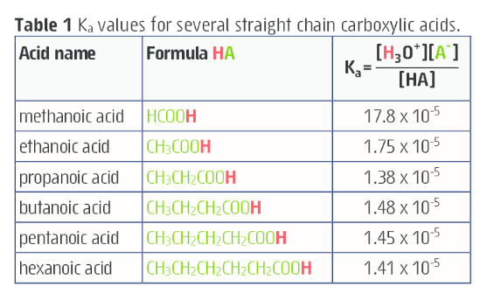
Carboxylic acids
Carboxylic acids are typically weak acids
Methanoic acid is the strongest aliphatic carboxylic acid
Phenyl carboxylic acids tend to be stronger weak acids than aliphatic derivatives

Slide 4
Carboxylic acids
Carboxylic acids and their solutions exhibit physical and chemical properties typical for acidic solutions:
They turn Blue litmus
Have a sour taste (think – what does citric acid taste like?)
Lets see what acid and base reactions you remember…
red

Slide 5
Reactions of carboxylic acids
Carboxylic acid + reactive metal (e.g. Na or K)
Carboxylic acid + strong base (e.g. NaOH)
Carboxylic acid + carbonate (e.g. Na₂CO₃)
Carboxylic acid + hydrogen carbonate (e.g NaHCO₃)

Slide 6
Reactions of carboxylic acids
Adding sodium carbonate to a suspected carboxylic acid producing a fizzing effect as a colourless, odourless gas, carbon dioxide, is produced. This effect is not seen with other common organic compounds so can be used as evidence to help identify unknowns.
This video shows the reactions we have discussed (plus a couple of extra reactions)
https://www.youtube.com/watch?v=1_-ZVyyEc2U

Slide 7
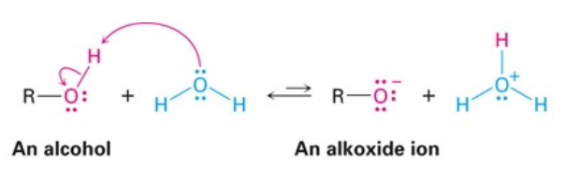
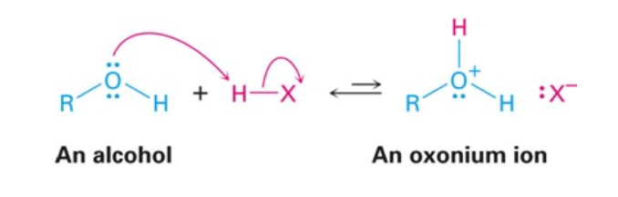
Alcohols
Alcohols, R-OH, can act as both a weak base and weak acid
Alcohol + strong acid
Alcohol + base

Slide 8
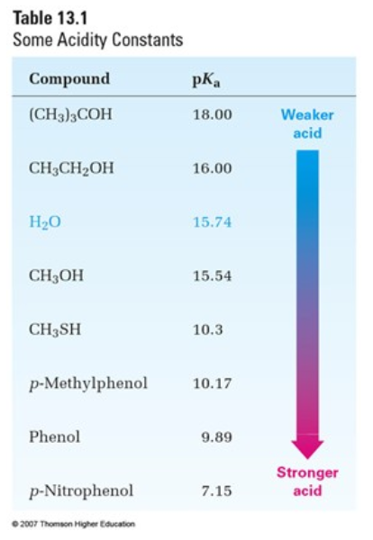
Alcohols
Strength of acid, HA in water can be expressed by an acidity constant, Ka
Compounds with smaller Ka values and therefore larger pKa values are less acidic
On this table methanol is slightly more acidic than water and ethanol is slightly less acidic
Notice that the lowest acidity is for the tertiary alcohol (CH₃)₃COH

Slide 9
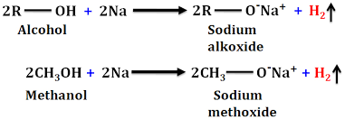
Alcohols
Alcohol + reactive metal
https://www.youtube.com/watch?v=LuicIvV3PjQ
Reactivity: 1° > 2° > 3°

